Slide 1

Spring Security
Suganya Anbumani
March 2011

Slide 2

Introduction
NTLM is a Microsoft-developed protocol providing single sign-on capabilities to web applications
It allows a web server to automatically discover the username of a browser client when that client is logged into a Windows domain
Built on using NTLM networking protocol.
Browser
Http Request
Challenge Msg
Negotiate Msg
Authenticate Msg
Challenge Msg
Http Response 200
Authenticate Msg

Slide 3

Spring Security Filters
Filter | Purpose
HttpRequestIntegrationFilter | Exposes the request context to the current thread
HttpSessionContextIntegrationFilter | Populates the SecurityContextHolder with information obtained from the http session
FilterSecurityInterceptor | Decides whether or not to allow access to a secured resource
AnonymousProcessingFilter | Used to identify an unauthenticated user as an anonymous user
ExceptionTranslationFilter | Handles any AccessDeniedException or AuthenticationException
LogoutFilter | Used to log a user out of the application
RememberMeProcessingFilter | Automatically authenticates a user who has asked to be “remembered” by the application
SecurityContextHolderAwareRequestFilter | Populates the servlet request with a request wrapper.
AuthenticationProcessingFilter | Accepts the user’s principal and credentials and attempts to authenticate the user
NTLMProcessingFilter | Handles SSO using NTLM protocol

Slide 4
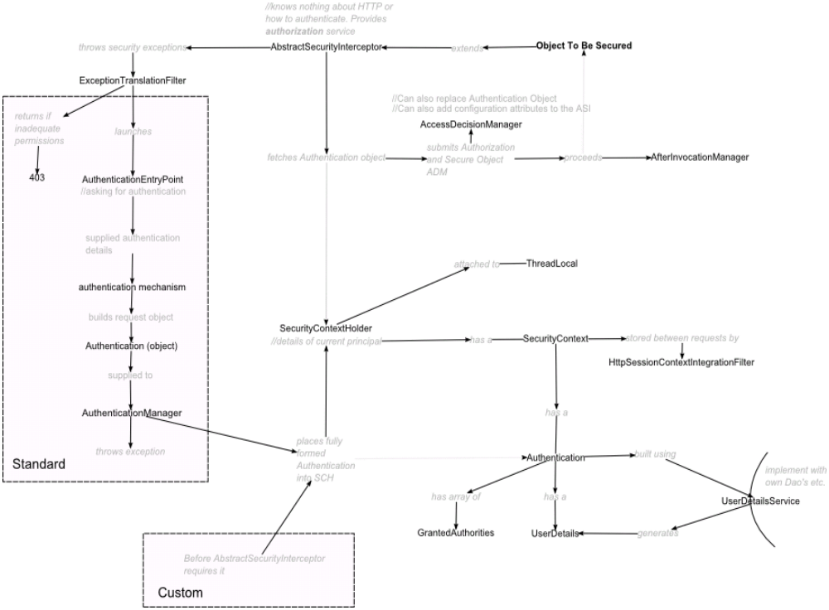
Flow Diagram

Slide 5
Configuration
In web.xml
<filter>
<filter-name>springSecurityFilterChain</filter-name>
<filter-class>org.springframework.web.filter.DelegatingFilterProxy</filter-class>
</filter>
<filter-mapping>
<filter-name>springSecurityFilterChain</filter-name> <url-pattern>/*</url-pattern>
</filter-mapping>
In Spring Configuration File
<bean id="filterChainProxy" class="org.springframework.security.util.FilterChainProxy">
  <security:filter-chain-map path-type="ant">
  <security:filter-chain pattern="/scripts/**" filters="none"/>
  <security:filter-chain pattern="/login-spring.*" filters="none"/>
  <security:filter-chain pattern="/j_spring_security_logout" filters="RequestContextFilter,httpSessionContextIntegrationFilter,logoutFilter"/>
  <security:filter-chain pattern="/**" filters="RequestContextFilter,httpSessionContextIntegrationFilter,exceptionTranslationFilter,ntlmFilter,filterSecurityInterceptor,logoutFilter"/>
  </security:filter-chain-map>
</bean>
<bean id="ntlmFilter" class="org.springframework.security.ui.ntlm.NtlmProcessingFilter">
<security:custom-filter position="NTLM_FILTER"/>
<property name="stripDomain" value="true"/>
<property name="defaultDomain" value=“nefdom1"/>
<property name="authenticationManager" ref="_authenticationManager"/>
</bean>

Slide 6
Application Context
<bean id="_authenticationManager"
class="org.springframework.security.providers.ProviderManager">
<property name="providers">
<list> <ref bean="daoAuthenticationProvider"/> </list>
</property>
</bean>
<bean id="daoAuthenticationProvider"
class="mpacp.security.UserDetailsAuthenticationProvider">
<property name="userDetailsService">
<ref local="UserDetailsServiceImpl"/>
</property>
</bean>
<bean id="UserDetailsServiceImpl"
class="mpacp.security.UserDetailsServiceImpl">
<property name="homeBeanClass" value="mpacp.web.bean.HomeBean"/>
</bean>
<bean id="ntlmEntryPoint" class="org.springframework.security.ui.ntlm.NtlmProcessingFilterEntryPoint">
<property name="authenticationFailureUrl" value="/access_denied.jsp"/>
</bean>
<bean id="exceptionTranslationFilter" class="org.springframework.security.ui.ExceptionTranslationFilter">
<property name="authenticationEntryPoint" ref="ntlmEntryPoint"/>
</bean>

Slide 7
<bean id="accessDecisionManager" class="org.springframework.security.vote.UnanimousBased">
<property name="allowIfAllAbstainDecisions" value="false"/>
<property name="decisionVoters">
<list>
<bean id="roleVoter" class="org.springframework.security.vote.RoleVoter"/>
</list>
</property>
</bean>
<bean id="filterSecurityInterceptor" class="org.springframework.security.web.access.intercept.FilterSecurityInterceptor">
<property name="authenticationManager" ref=“_authenticationManager"/>
<property name="accessDecisionManager" ref="accessDecisionManager"/>
<property name="securityMetadataSource">
<security:filter-security-metadata-source>
<security:intercept-url pattern="/mpacp/users**" access="ROLE_ADMIN"/>
<security:intercept-url pattern="/mpacp/**" access="ROLE_MANAGER,ROLE_TRADER"/>
</security:filter-security-metadata-source>
</property>
</bean>

Slide 8
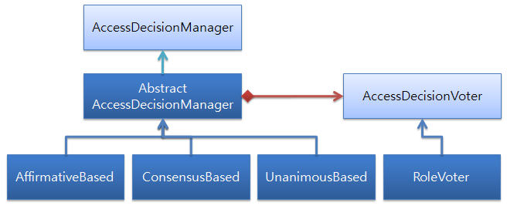
Access Decision Manager
Responsible for deciding whether the user has the proper access to secured resources by invoking Voters and tallying votes
Spring Security comes with three implementations of Access Decision Manager
Access decision manager | How it decides to grant/deny access
Affirmative Based | Allows access if at least one voter votes to grant access
Consensus Based | Allows access if a consensus of voters vote to grant access
Unanimous Based | Allows access if all voters vote to grant access

Slide 9
Spring AOP
Spring AOP
It is a simpler and more powerful way of writing custom aspects using either a schema-based approach or the @AspectJ annotation style. Both of these styles offer fully typed advice and use of the AspectJ pointcut language, while still using Spring AOP for weaving.
Terms – Aspect, Join Point, Advice
Types of Advice – Before, After, Around
package com.aop.demo.aspects
import org.aspectj.lang.annotation.Aspect;
import org.aspectj.lang.annotation.Pointcut;
import org.aspectj.lang.annotation.Before;
@Aspect
public class HelloWorldLoggerAspect{
@Pointcut("execution(*com.aop.demo.*.*(..))")
public void anyPublicMethod() {}
@Before(“anyPublicMethod()")
public void logMethodCall(){
System.out.println("The Hello World Method has been called.");
}
}

Slide 10
@Around(value= "execution(*com.aop.demo*.*(..)))
public Object checkSecurity(ProceedingJoinPoint call) throws Throwable {
Object obj = SecurityContextHolder.getContext().getAuthentication().getPrincipal();
AuthUser user = null;
if (obj instanceof AuthUser)
user = (AuthUser)obj;
else
throw new Exception("Credentials is wrong");
if(user!=null) {
Lookup company = user.getCompany();
//business logic
}
return call.proceed();
}
package com.aop.demo
public class HelloWorld{
public void sayHello(String name){
System.out.println("Hello " + name);
}
public static void main(String args[]){
HelloWorld hw = new HelloWorld();
hw.sayHello();
}
}
<aop:aspectj-autoproxy/> <bean id="helloWorldLoggerBean" class="com.veerasundar.aop.aspects.HelloWorldLoggerAspect" />

Slide 11
Advantages
Open Source
Fully java compatible
Integrates without major architectural changes
No need to write any authentication code
Disadvantages
Little complex to understand the filters
NTLM is not supported anymore by spring. Kerberos is the new protocol used
Requires manual configuration for non IE browsers

Slide 12
Dependent Jars
spring-security-core-2.0.4.jar
spring-security-ntlm-2.0.4.jar
jcifs-1.2.9.jar
To enable NTLM in firefox
Type about:config in the browser.
Find the key network.automatic-ntlm-auth.trusted-uris.
Enter the hostnames like: “host1.domain.com, host2.domain.com” or just “.domain.com” to list them all at once
Restart the firefox
.

